Slide 1
Crossover in EAs 2: building blocks etc
Richard A. Watson
ECS, Southampton University, UK

Slide 2
Revision
What is the problem with sex
  Two-fold cost of sex
Some evolutionary biology models for the benefit of sex
  Fisher/Muller
  Muller’s Ratchet

Slide 3
Revision: Fisher/Muller hypothesis (1930)
B
B
Proportion of population
A+B
A
A
ab
time
Linkage disequilibrium created by new mutations in finite populations.
Decrease in L.D. beneficial because removes competition between simultaneously segregating beneficial alleles
i.e. sex is advantageous because it allows alleles to be selected for independently
Notes:
Y axis

Slide 4
As we saw before
00100000000010000001 3
00000100000010001000 3
Asexuals can only produce more of these two genotypes
How many possible genotypes can uniform crossover create from these two genotypes?
How many from one-point crossover?

Slide 5
Uniform crossover creates all of these
00100000000010000001 3
00100000000010000000 2
00100000000010001001 4
00100000000010001000 3
00100100000010000001 4
00100100000010000000 3
00100100000010001001 5
00100100000010001000 4
00000000000010000001 2
00000000000010000000 1
00000000000010001001 3
00000000000010001000 2
00000100000010000001 3
00000100000010000000 2
00000100000010001000 3

Slide 6
Focussing variation
‘focussing search’, Prügel-Bennett (ECS)
i.e. uniform crossover of these two strings
00101001010110111110100010010010000001010110
00101001011110111110100010010000000111010010
----------?-------------------?----??-------
Only creates variation at loci where the parents differ whereas mutation creates variation at all loci
(See also “Is the common good” Chen 1999)

Slide 7
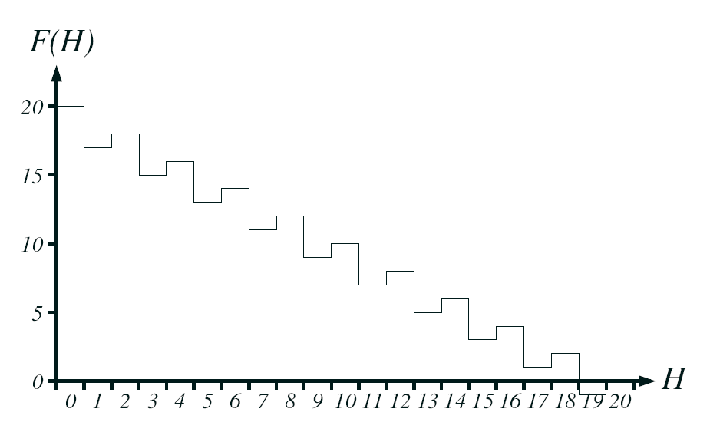
Hurdles problem (Prügel-Bennett)
Two-point mutation.
Mutations to jump final hurdle occur with prob?
  1/L^{k} (where k is width of gap between hurdles = 2)
Prob of uniform crossover for two individuals that differ by 4 bits?
  1/2^{(k*2)}

Slide 8
What crossover can do that hill-climbers cannot (without using building blocks)
Shapiro and Prugel-Bennet (1997) ‘two wells’/’basin with a barrier’
Thomas Jansen (2001)
  ‘Gap’/’jump’ function
P1: 11110101111101011111
P2: 11111011100111111111
C1: 1111???11??1?1?11111

Slide 9
One point crossover creates only these
00100000000010000001
00100000000010000000
00100000000010001000
00100100000010001000
00000100000010001000
Two of these are one-point mutations from one of the parents, but the rest are more than one point mutations – therefore quite unlikely for mutation hill-climber to find
And these particular ones each occur with probability 1/k not 1/2^{k}

Slide 10
Is there a further bias here that might be exploited?
What’s special about this subset of strings that can be made by one-point (or low rates of crossover) that uniform crossover is unlikely to make?
Ans: The bits that appear together in the offspring are close to each other on the chromosome/genome.
i.e.: The bits that stay together are physically linked.

Slide 11
Schemata and building blocks
Holland: Schema Theorem (1975)
  Increase in frequency of schemata of above average fitness
Goldberg: Building Block Hypothesis (1989)
  Emphasis on combining fit low-order schemata into higher-order schemata of higher fitness

Slide 12
Schemata and building blocks
What do you notice about these individuals?
110101000010010000
010101000010101001
110101001010010011
110101001101011011
*1010100*******0** they all contained in this schema
(the schema is the set of all strings that contain that subset of alleles)
***1********0*0*** an ‘order’ 3 schema
***11*0*********** a ‘shorter’ order 3 schema
Building-block – a low-order, short defining length schema of above average fitness

Slide 13
Schemata and building blocks
What is the highest order schema that contains these individuals?
111101001
010101011
110111010
110111000
*1*1*10**
What order is it?
What is its defining length?
How many strings are in that schema?
What is a Building-block?

Slide 14
Building-block ideas
Holland 1975, Goldberg 1989 and others proposed that this is the reason that GAs work well
  A GA first finds small schemata
  Then crossover puts small schemata together to find bigger ones
  And bigger and bigger until the whole problem is solved.
Mitchell and Forrest (1991-1995)
  Set out to test this is correct by making an idealised problem where low order schemata of short defining length and above average fitness are known to be present
  And they can be combined together to make bigger ones
  “Royal Roads”

Slide 15
Royal Roads
11111111******************************************************** 8
********11111111************************************************ 8
****************11111111**************************************** 8
************************11111111******************************** 8
********************************11111111************************ 8
****************************************11111111**************** 8
************************************************11111111******** 8
********************************************************11111111 8
1111111111111111************************************************ 16
****************1111111111111111******************************** 16
********************************1111111111111111**************** 16
************************************************1111111111111111 16
11111111111111111111111111111111******************************** 32
********************************11111111111111111111111111111111 32
1111111111111111111111111111111111111111111111111111111111111111 64

Slide 16
What happened?
GAs work fine on RRs… but
Random mutation hill-climber works better!
→ general failure to demonstrate anything a GA can do that a hill-climber cannot do!
a good example of
  enthusiastic attachment to an overcomplicated approach (bad)
  i.e. a simpler algorithm is better
  but also, idealising benefit to test hypothesis (good)
also
  concatenated trap functions (Deb and Goldberg 1993)
  macro-mutation hill-climber/ headless chicken test (Jones 1995)
failure of the BB school: if its inferior on an idealised problem then the BB school of GA theory must be rubbish

Slide 17
Some successes in showing something crossover can do that hill-climbers cannot – without using building blocks
Shapiro and Prugel-Bennet (1997) ‘two wells’/’basin with a barrier’
Thomas Jansen (2001)
  ‘Gap’/’jump’ function
P1: 11110101111101011111
P2: 11111011100111111111
C1: 1111???11??1?1?11111

Slide 18
Some successes with building blocks
.
Jansen (2001)
  ‘Gap’ function w. bonus for tight linkage of 1s
P1: 0001111111100000
P2: 1110000000011111
C1: 1111111111111111
Hierarchical-IFF: Watson (2000)
  Hierarchical modular building-block problem
  Hill-climber O(2^{N/2})
  GA with tight linkage can solve in O(N²log²N)
P1: 1111111100000000
P2: 0000000011111111
C1: 1111111111111111

Slide 19
The good news and bad news
Good news
  It verifies that some kind of GA on some kind of problem can utilise advantage of building-block recombination under some circumstances
  It solves this kind of problem in polynomial time whereas any kind of hill-climber (or uniform crossover) takes exponential time
Bad news
  Its not a standard GA or a ‘standard’ problem
  What’s it got to do with any practical engineering problem?
  What’s it got to do with any real biology?
Can simpler models show the same thing?...

Slide 20
A simple two module model
Nucleotide sites within a gene are grouped both functionally and physically by virtue of shared transcription and translation. →
A simple form of biologically-real modularity.
i
gene 1
j
gene 2
✓✓✓✗ ✗ ✓✗ ✗✓✓✓ ✓✓✓✓✓✓✓✓✓✓✓
Assume mutations in the same gene have stronger synergy than mutations in different genes
  i.e. more beneficial mutations there are within a gene, the more effect additional mutations have. Equivalently, the closer to proper/complete functioning the gene is, the more important mutations are.
  e.g. each deleterious mutation halves binding affinity - exponential decay with distance from ideal sequence

Slide 21
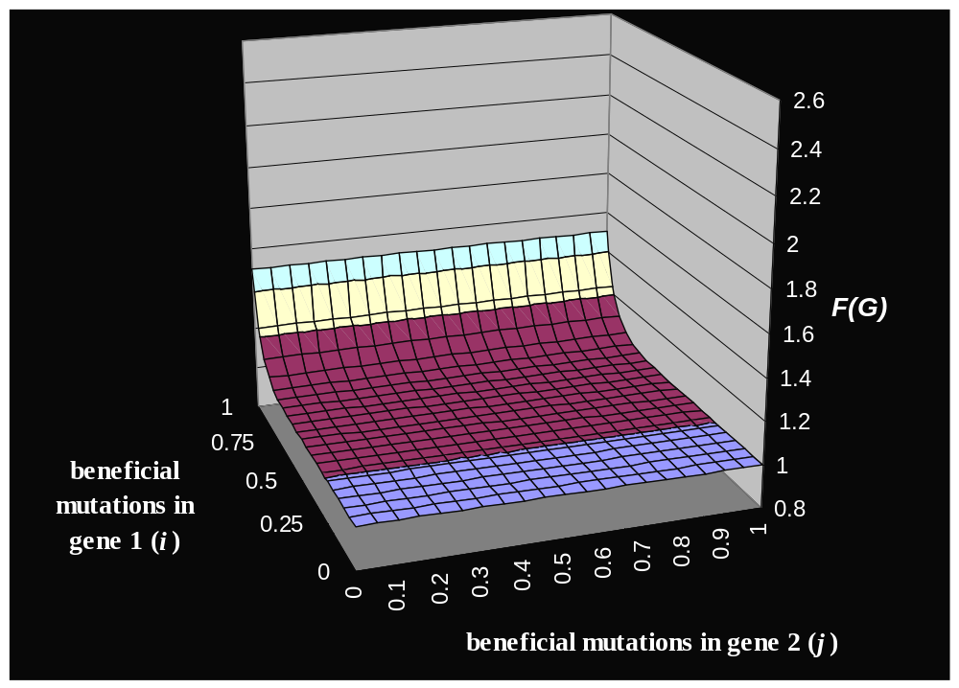
Multiplicative in gene 1 only
e ^{i}

Slide 22
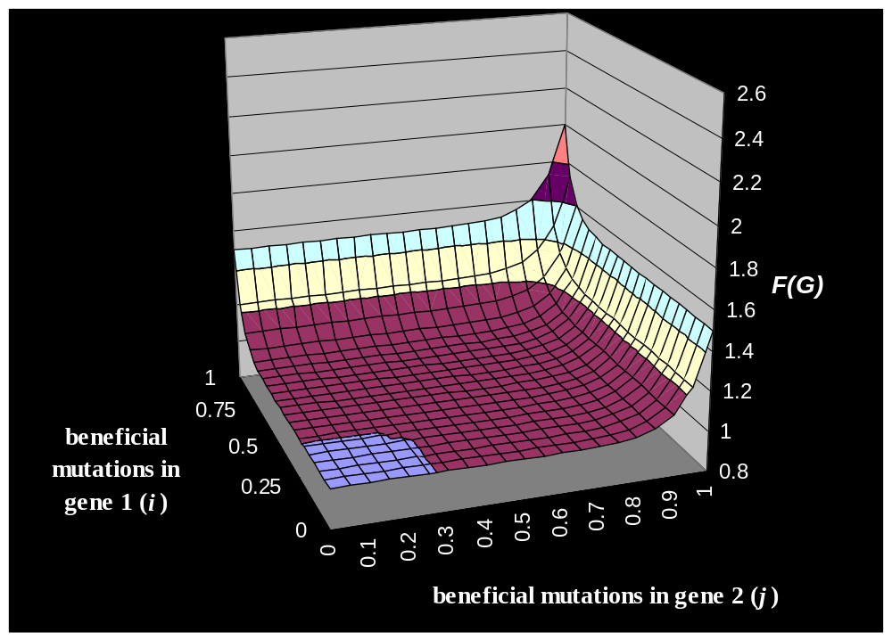
Synergistic epistasis within genes
(e ^{i}+e ^{j})

Slide 23
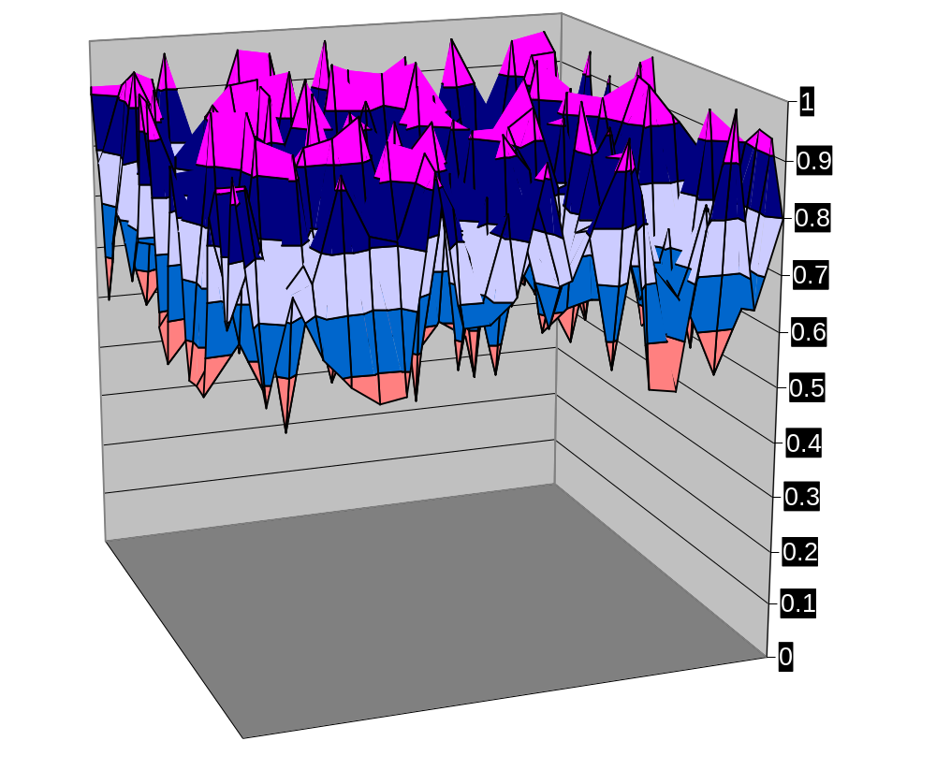
Random epistasis among all loci
R_{i,j}
F(G)
1
0.75
beneficial
0.5
mutations in
gene 1 (
i
)
0.25
0.7
0.8
0.9
0
0.4
0.5
0.6
0
0.1
0.2
0.3
beneficial mutations in gene 2 (
j
)

Slide 24
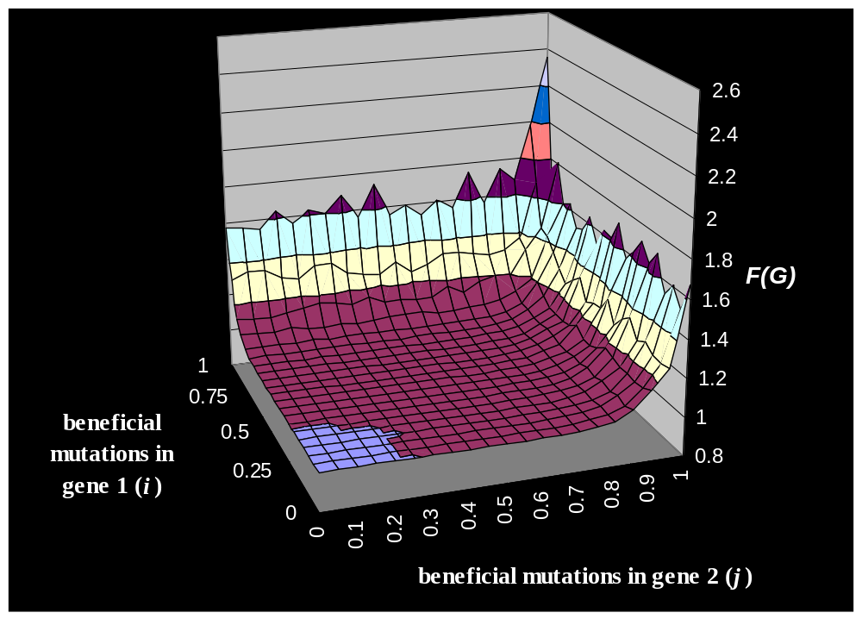
Synergistic epistasis within genes and random epistasis
(e ^{i}+e ^{j})R_{i,j}

Slide 25
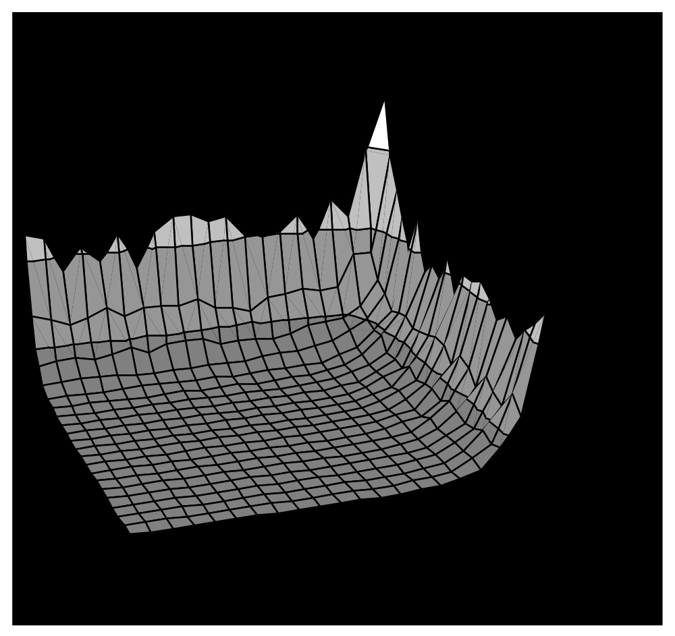
Simple analysis: without recombination
2^{k}
Finding peak of one gene is easy.
Finding the peak of the second gene without disrupting the first is difficult.
k
^{k}
T 2^{k}
gene 1
gene 2

Slide 26
Simple analysis: with recombination
gene 1 gene 2
----✓✓✓✓✓✓✓✓----✓✓✓✓✓✓✓✓---
gene 1 gene 2
----✓✓✓✓✓✓✓----✗✗✓✗✗✓✓✗---
gene 1 gene 2
----✓✓✓✗✗✓✗✗----✓✓✓✓✓✓✓✓---
k
T k
gene 1
gene 2

Slide 27
Simulation study
Sufficient diversity required.
Multi deme model
    50 demes of 200 individuals each
    Island migration (0.005)
    Mutation (0.03 per site)
    Recombination: crossover 0.0, 0.013 (1/L), 0.5
    Two genes, 40 sites each
    1% Elitism: retain fittest 2 individuals in each deme
Simulation example…

Slide 28
Unlike other building block problems
In Royal roads and concatenated trap functions, as the building blocks get bigger they become more difficult to solve for both mutation-only algorithms but also more difficult to find for GAs with crossover
The trick in this problem is that the epistasis is set-up so that its easy to find the first block, but after you’ve found one block it becomes hard to find the other… so you cant find them in series (by mutation), you have to find them in parallel (and assemble by crossover).
  For large building blocks its still easy to find the first one, but impossibly hard to find the second one (by mutation)

Slide 29
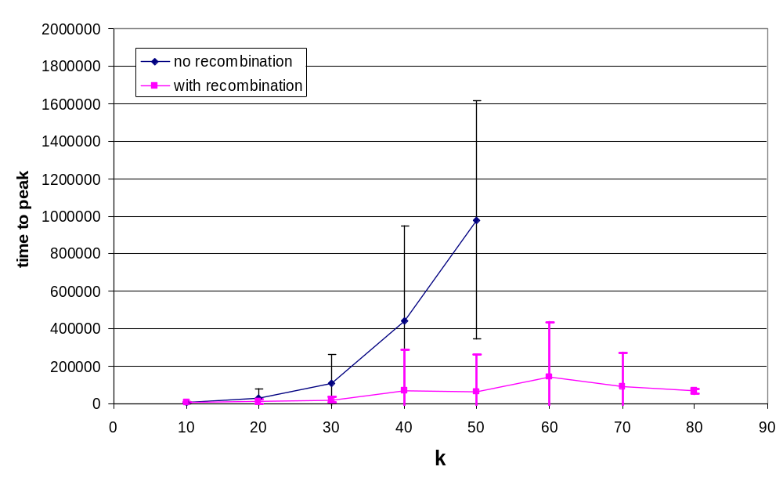
Simulation results
Size of block

Slide 30
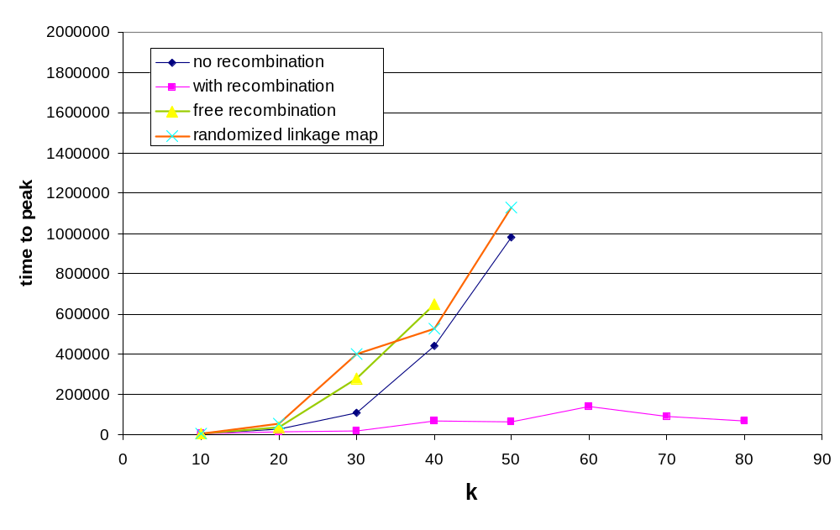
Simulation results - controls

Slide 31
Two scales of search
In GA terminology
  Mutation on individual genes finds good building blocks
  Recombination of building blocks finds good genotypes
In bio terminology
  genes don’t create blocks like this in real genomes, but
  Scale down metaphor: change ‘gene’ to ‘nucleotide’, and ‘building block’ for ‘gene’, then
  Nucleotides DO create blocks like this in real genomes (and the blocks are called genes!), So..
  Mutation on individual nucleotides finds good genes
  Recombination of genes finds good genotypes

Slide 32
Summary
EC and EB have very different approaches to modelling sex…
Evolutionary biology models largely focus on decreasing associations
Evolutionary computation seems to focus on creating associations
Some EC models show that GA with sex can solve some things that hill-climbers cannot solve
  Some use selection on individual bits (Prugel-Bennett, Jansen) with uniform crossover
  Some use Building blocks (Watson, Jansen) with one- or two-point crossover

Slide 33
Other example
Separable BB problem
Problem decomposition

